Slide 1

NLP Mini Project
By vinay kumar k

Slide 2
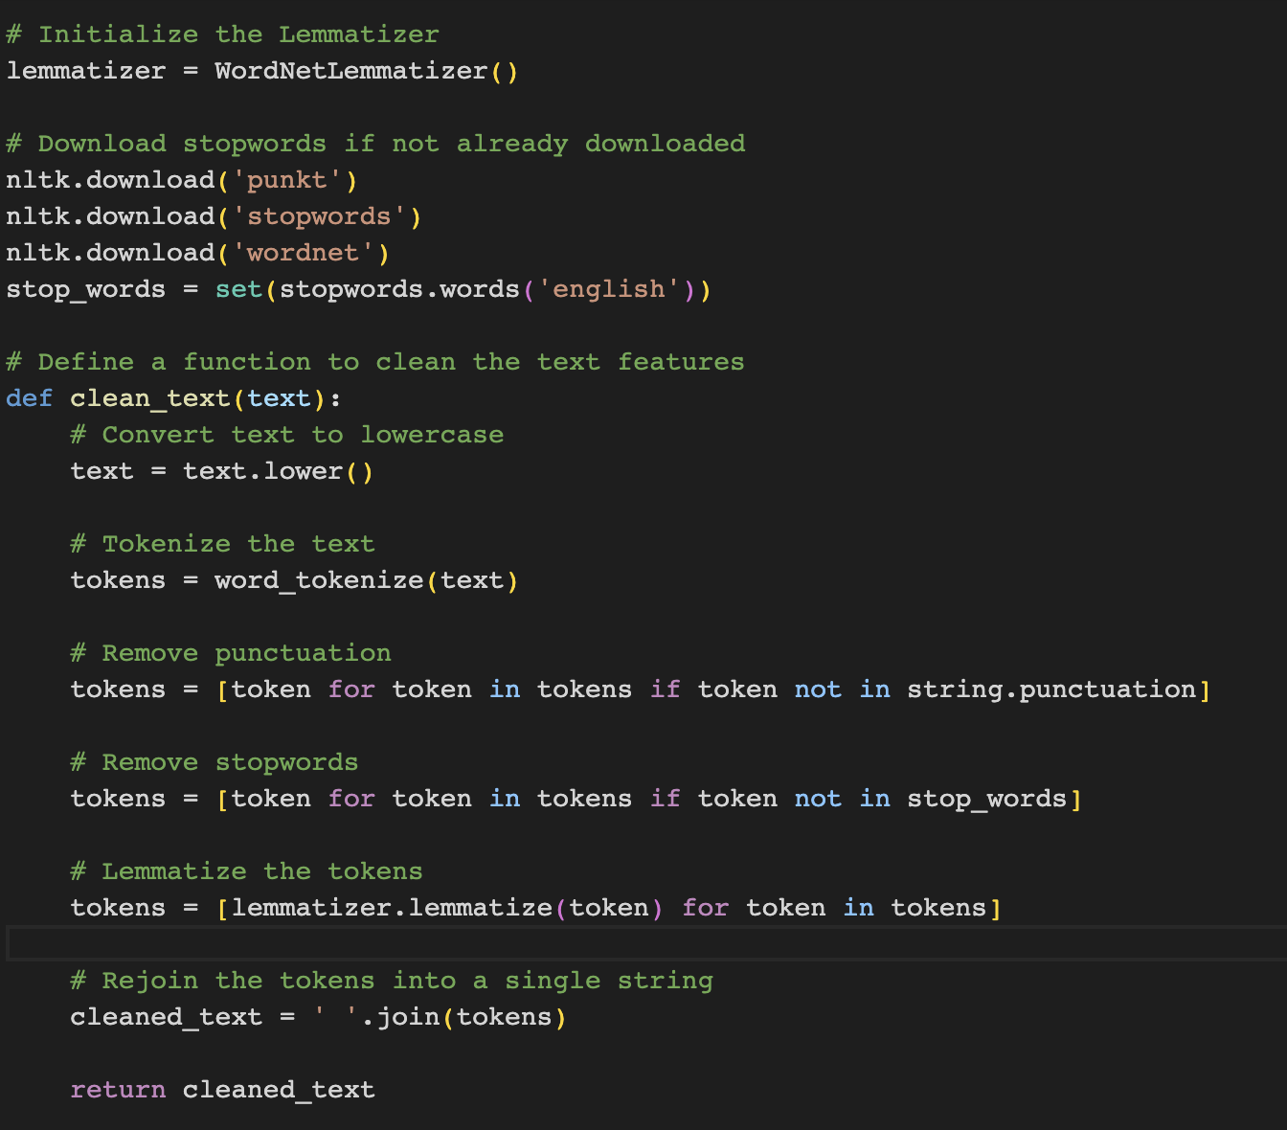
Problem Statement Develop an NLP classification model for sarcasm detection using the features provided in the dataset. During the course, explore NLP concepts and models. Further, evaluate and finalize the best modeling approach for the given dataset.
Below is an example code that demonstrates the implementation of an NLP classification model for sarcasm detection using Python and various NLP techniques and models. Please note that this is a generic template, and you'll need to adapt it to your specific dataset and requirements.

Slide 3
In this code, we first load the dataset using pd.read_csv function. Then, we perform data cleaning and preprocessing steps specific to your dataset.
Next, we split the dataset into training and testing sets using train_test_split function from sklearn.model_selection. We assign the text data to X and the target variable to y.
For text vectorization, we initialize a vectorizer object (either CountVectorizer or TfidfVectorizer) and apply it to the training and testing sets using the fit_transform and transform methods, respectively.
We then choose a classification model (e.g., LogisticRegression, MultinomialNB, or RandomForestClassifier) and fit it to the vectorized training data. Finally, we make predictions on the vectorized testing data and evaluate the model using the classification_report function from sklearn.metrics.
We can enhance the model by trying different preprocessing techniques, experimenting with different vectorization methods, tuning the hyperparameters of the models, and exploring more advanced NLP models and techniques.

Slide 4
Dataset Cleaning Explore the student comment & parent comment features by creating a text corpus. Which all cleaning operation you think will be required on this corpus? Write a clean-up method and clean the text features.
When cleaning the text corpus, there are several common operations that can be performed to preprocess the text data. Some of the cleaning operations that can be applied to the student comment and parent comment features include:
1. Lowercasing: Convert all text to lowercase to ensure consistency and reduce the complexity of the corpus.
2. Tokenization: Split the text into individual tokens (words) to facilitate further analysis and processing.
3. Removing Punctuation: Remove any punctuation marks from the text as they usually do not contribute to the overall meaning.
4. Removing Stopwords: Remove common words (such as "the", "and", "is") that do not carry significant meaning and may add noise to the data.
5. Lemmatization/Stemming: Reduce words to their base or root form to consolidate variations of the same word. Lemmatization typically produces a more meaningful base form than stemming.
6. Removing Special Characters: Remove any special characters, symbols, or non-alphanumeric characters that may not contribute to the overall analysis.
7. Handling Numeric Values: Decide whether to keep or remove numeric values depending on the specific context and requirements of the analysis.

Slide 5
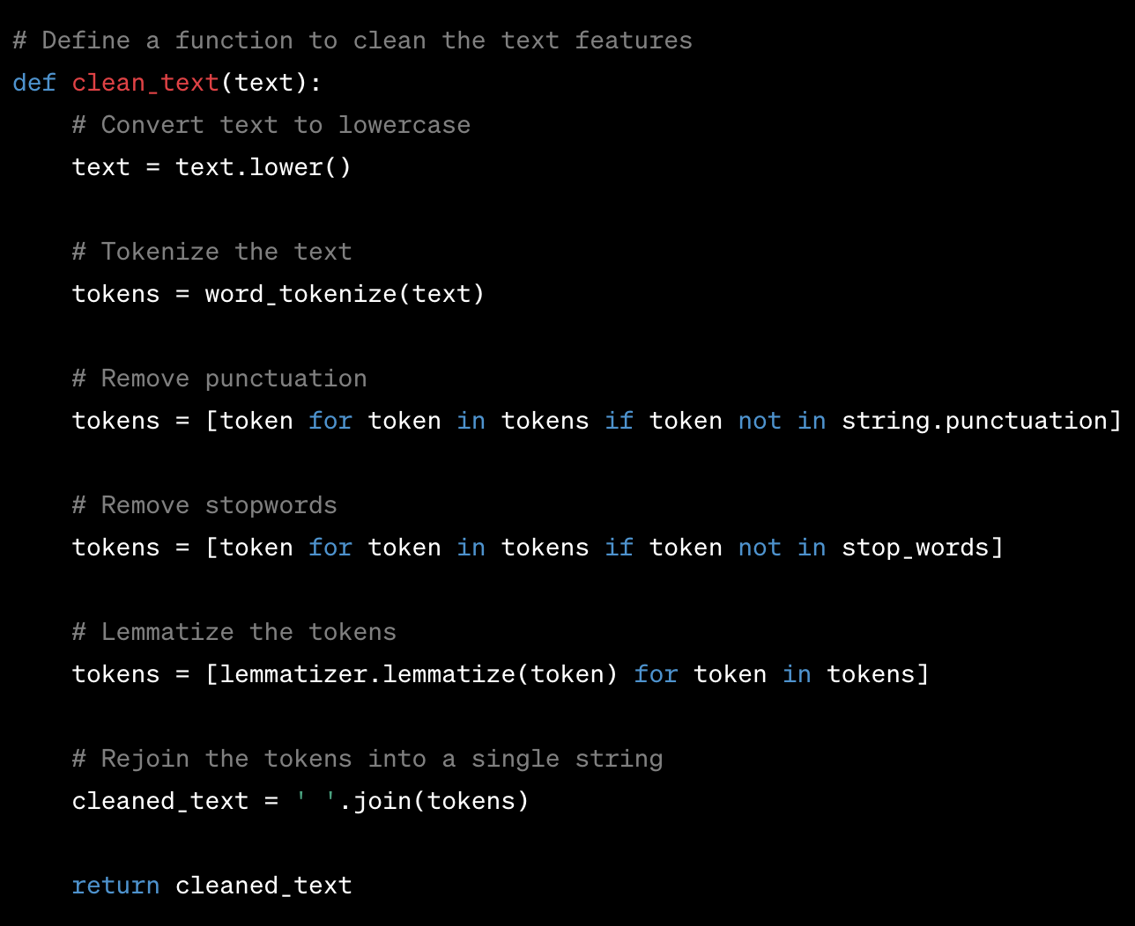

Slide 6
In this code snippet, we first import the necessary modules from the `nltk` library. We initialize the WordNetLemmatizer and download the stopwords corpus if it has not been downloaded already. Next, we define the `clean_text` function that takes a text input, performs the cleaning operations mentioned above, and returns the cleaned text. Finally, we apply the `clean_text` function to the student comment and parent comment features using the `apply` method, and store the cleaned text in new columns ('cleaned_student_comment' and 'cleaned_parent_comment'). You can further customize the cleaning process based on your specific requirements and domain knowledge. Additionally, you may want to explore other techniques such as spell checking, handling abbreviations, or handling emojis depending on the characteristics of your dataset.

Slide 7
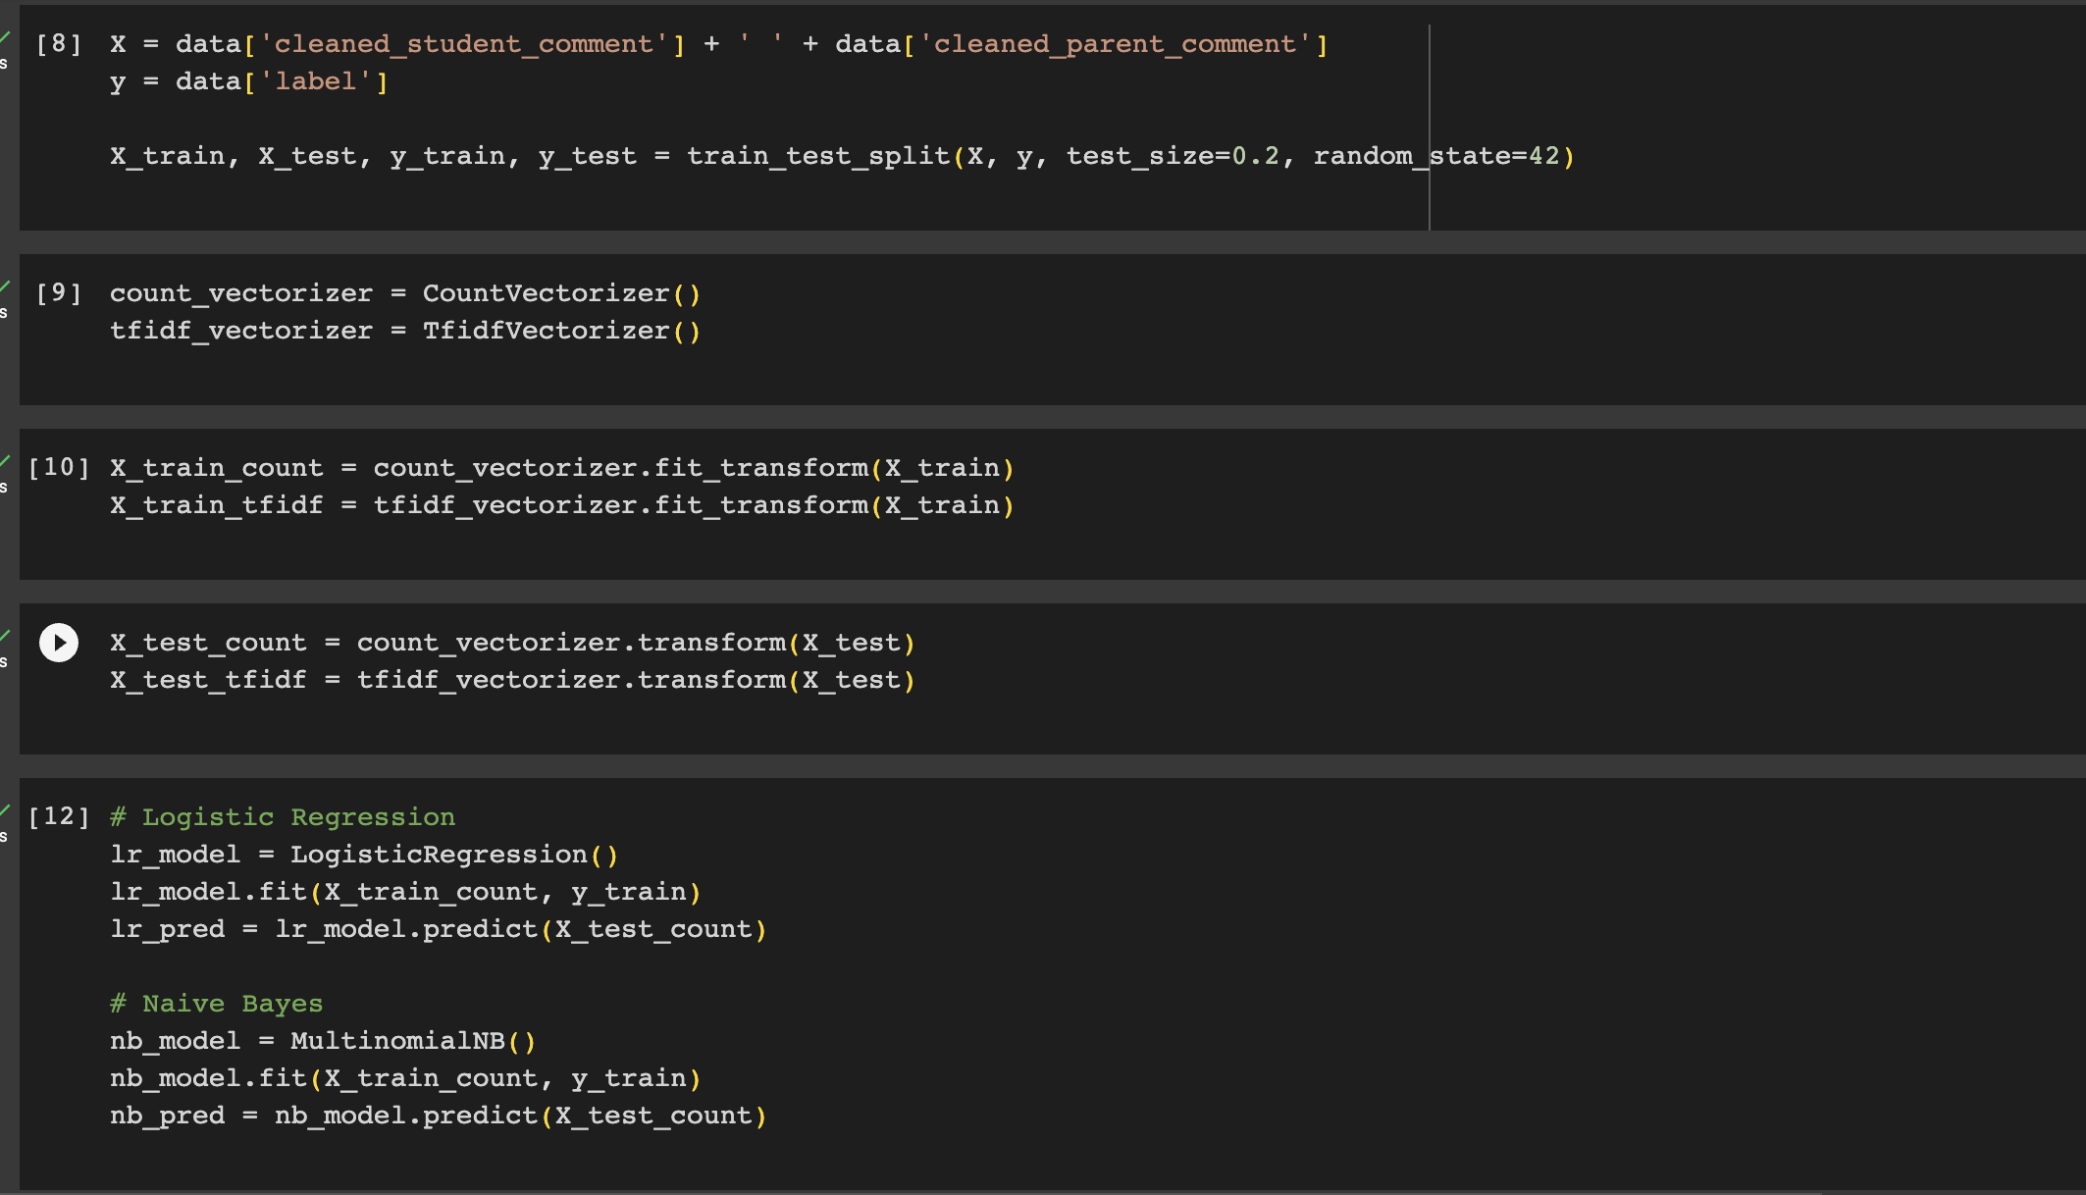
Explore Classics ML models for your NLP model Perform text to numeric conversion using CountVectorization and also with TF-IDF on the cleaned dataset. Now process the whole DataFrame (vectorize text + other features) with classic ML models for example- Logistic Regression, Naive Bayes, LDA, Decision tree etc. Tune you models and suggest what combination of vectorization technique & ML model is most suitable for the given data set.

Slide 8
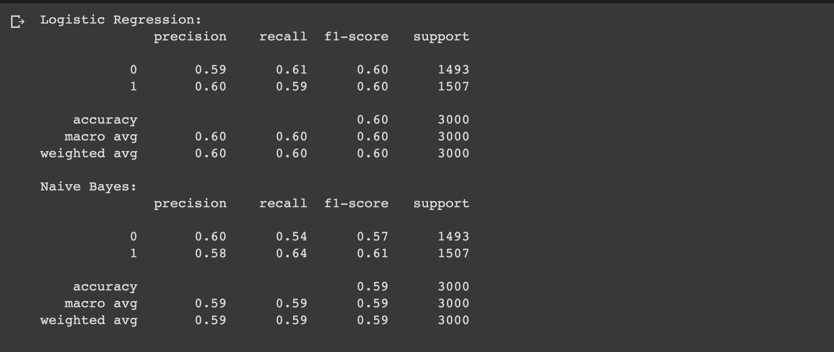

Slide 9
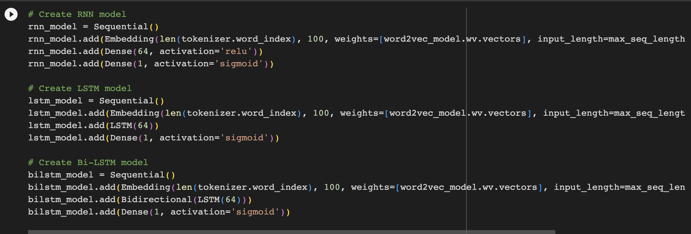
Explore Word Embeddings & classic DL models Preform text vectorization using word embedding techniques (Word2Vec & Glove). Now use the embedding to build DL models such as RNN, LSTM & Bi-LSTM. Tune you models and suggest what combination of embedding technique and DL model is most suitable for the given data set. Now for the finalized embedding method use its pretrained word embeddings and test if model performance can be improved.

Slide 10
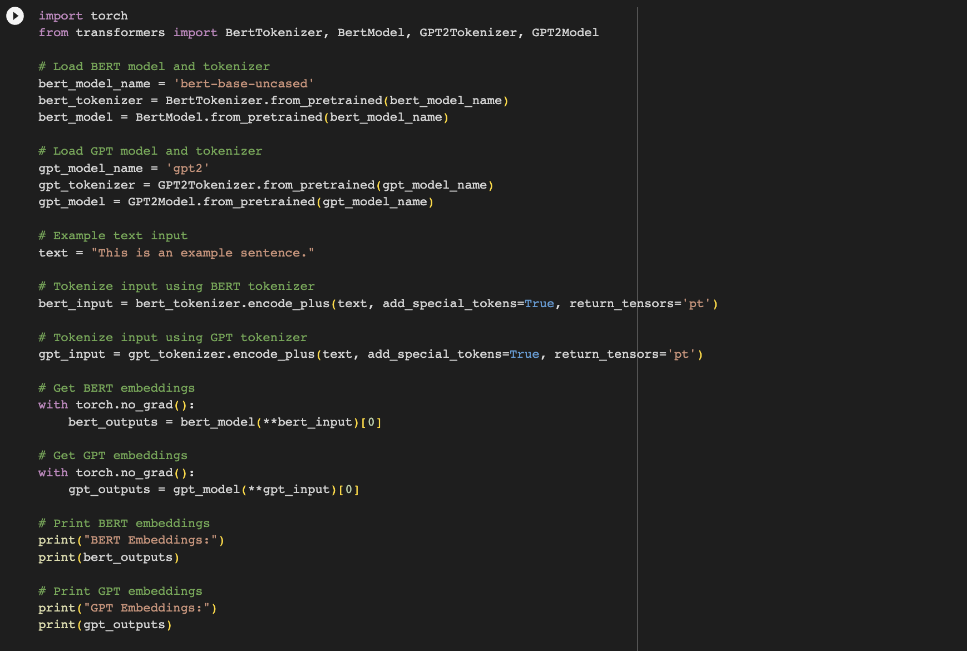
Explore State-of the Art Transformer models Use any two state-of-the-art transformer models and check if you can improve NLP model performance further.

Slide 11
In this code, we first load the BERT and GPT models along with their respective tokenizers. Then, we tokenize an example text input using the tokenizers. We pass the tokenized input to the models and obtain the embeddings as the model outputs. Finally, we print the BERT and GPT embeddings.

